Slide 1

Career Aspirations of Gen Z
By Ankit Rai

Slide 2

Introduction
The modern workforce is witnessing a growing disconnect between Gen Z individuals and employers. Born between 1995 and 2012, Gen Z has been shaped by rapid technological advancements, fueling aspirations for meaningful work, flexibility, and alignment with organizational values. However, many struggle to secure roles that match their passions and goals.
Employers, on the other hand, face challenges in attracting and retaining Gen Z talent, as traditional recruitment and retention strategies fail to address this generation's emphasis on innovation, work-life balance, and rapid career progression. This misalignment has led to dissatisfaction among Gen Z employees and high turnover rates for organizations.
This project aims to identify the root causes of this gap, analyze its impact, and propose actionable solutions to create a collaborative, adaptive, and thriving work environment for both Gen Z and employers.

Slide 3
Project Objectives
Identify Challenges: Assess issues faced by Gen Z in finding fulfilling roles and by employers in attracting and retaining young talent.
Analyze Expectations: Compare Gen Z’s priorities, such as career growth and work-life balance, with traditional organizational pratices.
Highlight Gaps: Identify disconnects between Gen Z’s aspirations and employers’ strategies.
Solutions for Gen Z: Develop strategies for enhancing employability and aligning skills with industry demands.
Solutions for Employers: Recommend modern practices to attract and retain Gen Z talent, focusing on flexibility, meaningful work, and career progression
Foster Understanding: Promote communication and collaboration between Gen Z and employers for mutual benefit.
Global Insights: Provide solutions applicable across industries and regions.

Slide 4

Problem Statement
Gen Z individuals struggle to find roles that align with their passions and aspirations due to a mismatch between their expectations and organizational practices. Employers face challenges in attracting and retaining Gen Z talent as traditional recruitment and retention strategies fail to address their priorities, such as work-life balance, flexibility, and career growth. This disconnect leads to dissatisfaction among Gen Z and high turnover rates for employers, impacting workforce stability and individual career fulfillment.

Slide 5
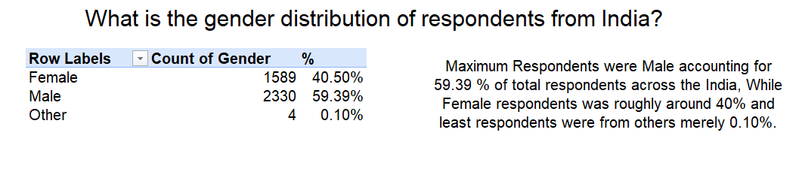
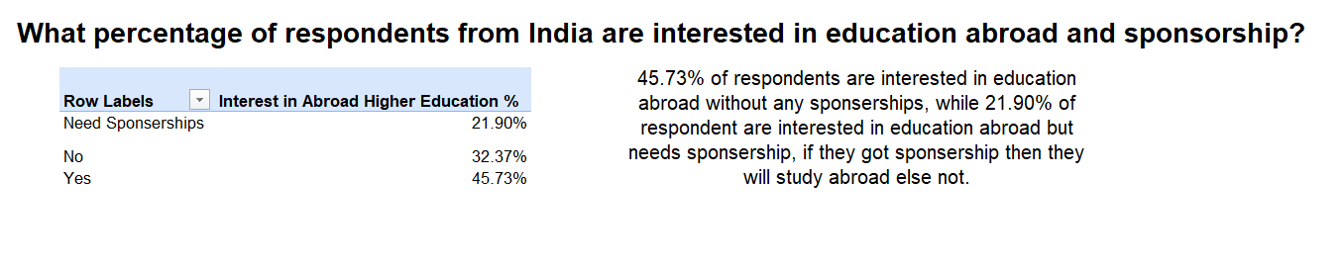
Key Findings

Slide 6
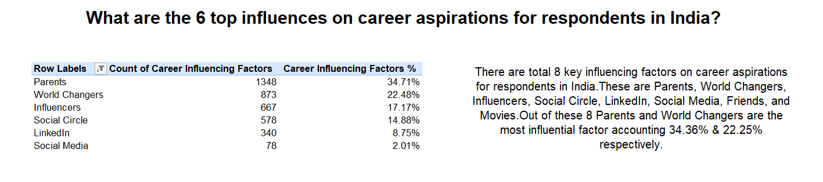
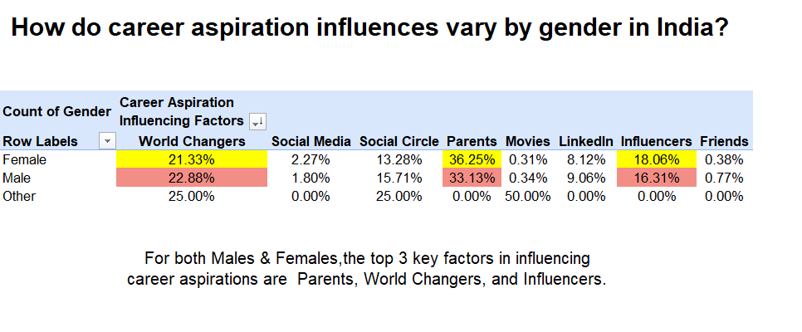

Slide 7
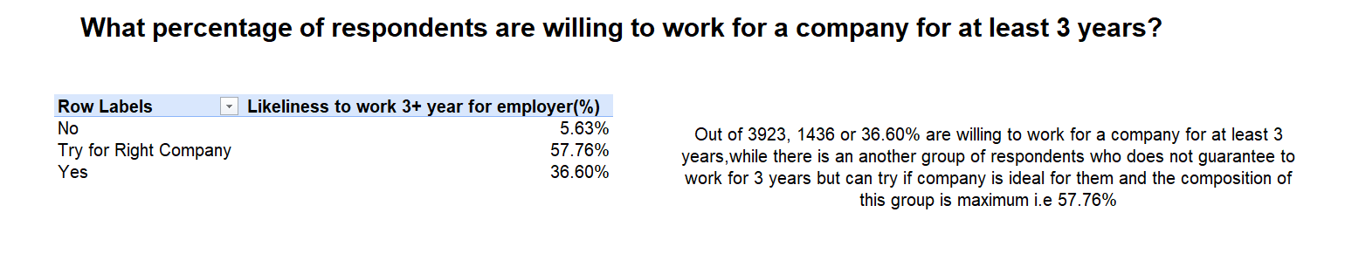
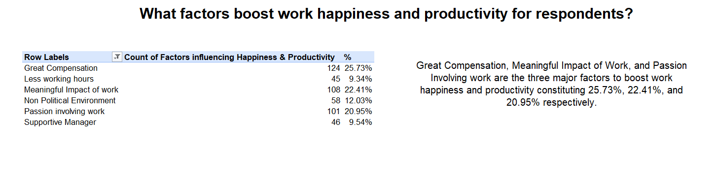

Slide 8
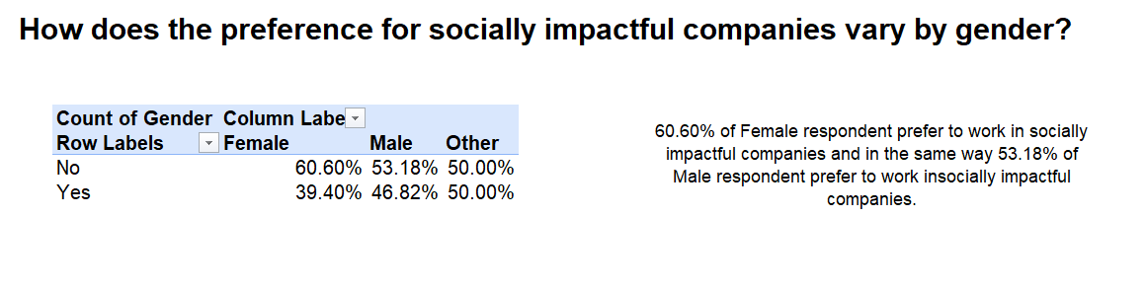
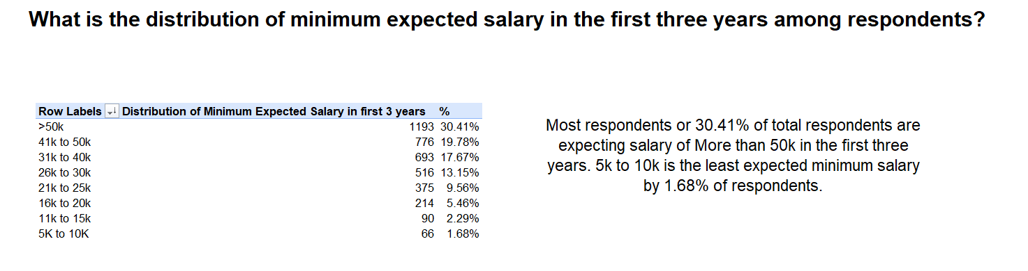

Slide 9
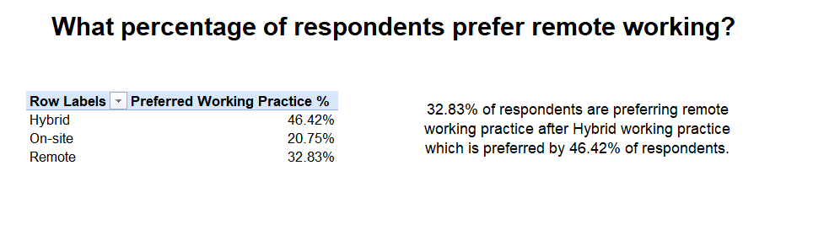
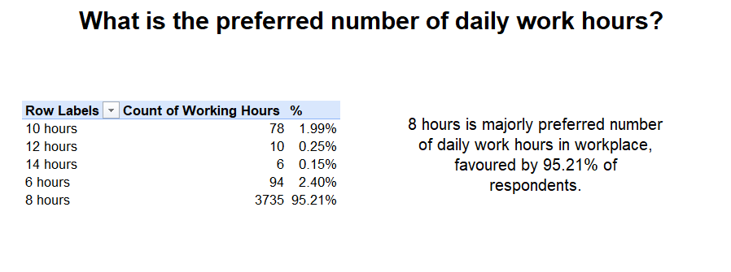

Slide 10
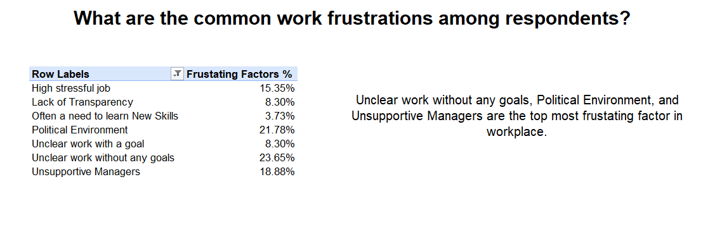
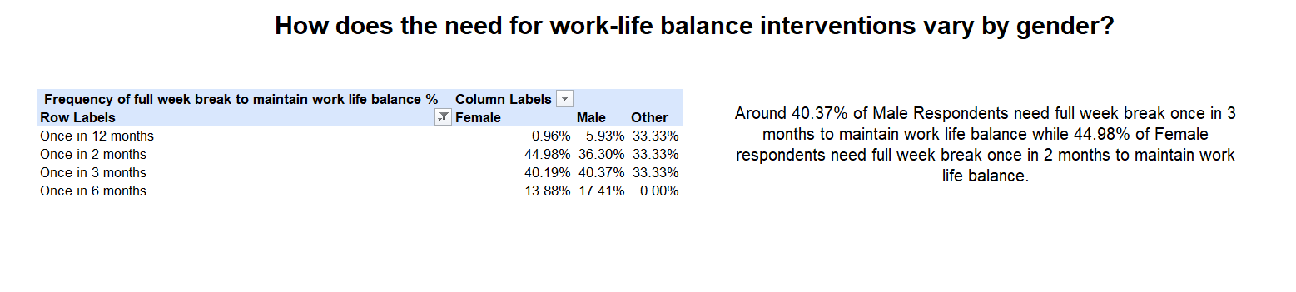

Slide 11
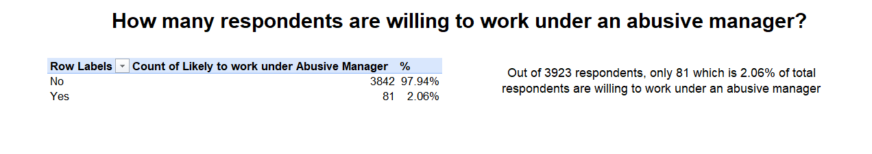
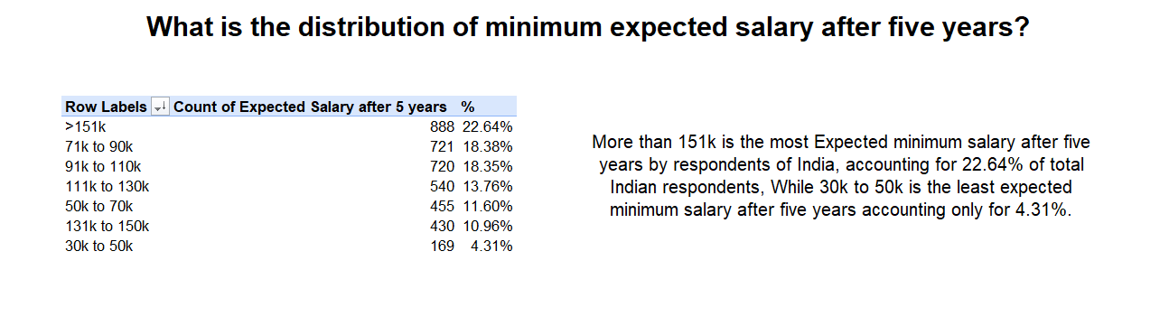

Slide 12
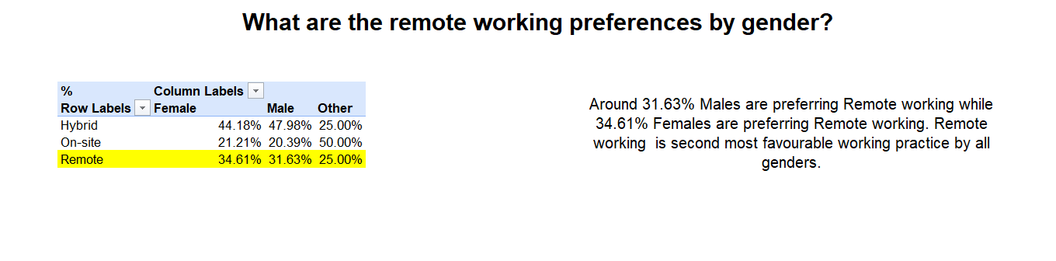
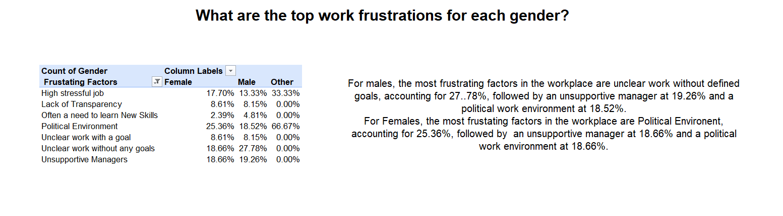

Slide 13
“WOW” Insights
For Gen Z, Still Parents are the top most key factor in influencing Career aspirations.
Gen Z’s are more oriented towards personal growth and opportunities instead of looking for stability.
Gen Z’s are now more inclined towards Remote and Hybrid working as compared to on-site working policy.
8 hours is the most preferred number of working hours by Gen Z roughly around by 95%.
77.19 % Gen Z’s are ready to work in companies which recently laid off employees.

Slide 14
Recommendations
Companies should provide more Remote and Hybrid Working Policy.
Companies should clearly provide their missions and impact.
Gen Z should keep themselves updated with newly technologies.
Employers should create an healthy and learning environment in companies.
Gen Z should look for practical approaches not only theoretical aspects.
Transparent Communication between Employer and Gen Z aspirants.

Slide 15
Lessons Learned
Learned to create documentation and understand Problem statement using 4 common themes-Issue/Challenge, Cause, Impact and Potential Solution.
Learned to do effective data cleaning such as data standardization and handling values.
Effective use of Pivot Tables to get answers of business questions or problems and to create a visually Appealing Dashboards.
Effective use of slicers and its customisation.

Slide 16
Thankyou !!

